Slide 2
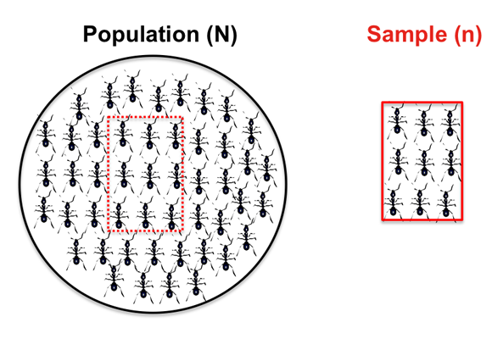
INTRODUCTION
  Sampling is the process of selecting observations (a sample) to provide an adequate description and inferences of the population.
  Sample
    It is a unit that is selected from population
    Represents the whole population
    Purpose to draw the inference
  Why Sample???
  Sampling Frame
  Listing of population from which a sample is chosen.

Slide 3
SAMPLING
What you actually observe in the data
What you want to talk about
Population
Sampling Process
Sampling Frame
Sample
Inference

Slide 4
If the population is Homogeneous
A homogeneous population is one where all individuals can be regarded as the same type.

Slide 5
If the population is HETEROgeneous
A heterogeneous population is one containing subpopulations of different types.

Slide 6
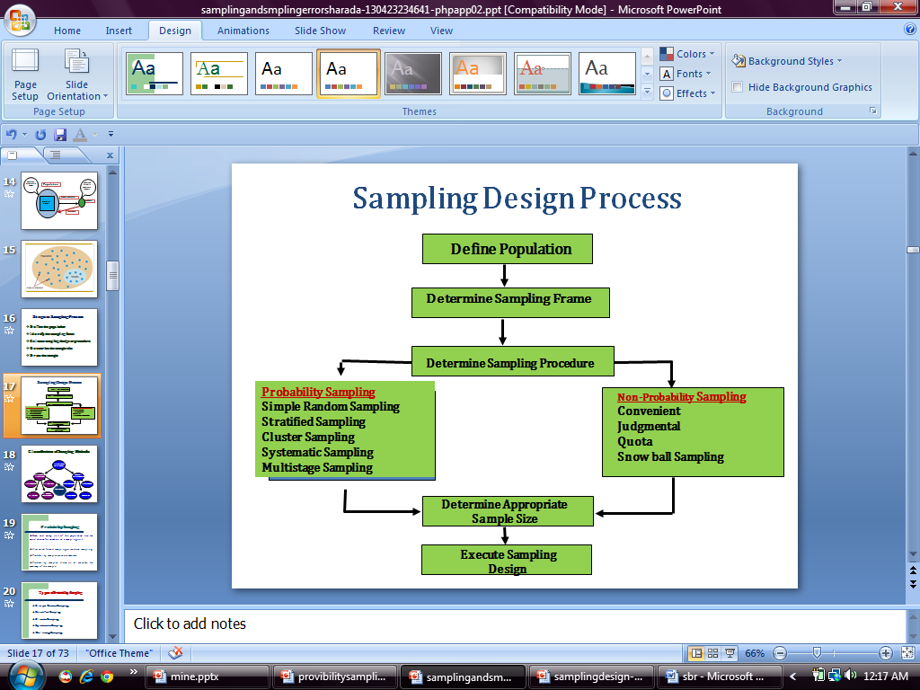
SAMPLING DESIGN PROCESS

Slide 7
PROBABILITY SAMPLING
A probability sampling method is any method of sampling that utilizes some form of random selection. In order to have a random selection method, you must set up some process or procedure that assures that the different units in your population have equal probabilities of being chosen.

Slide 8
SIMPLE RANDOM SAMPLING
All subsets of the frame are given an equal probability.
Random number generators

Slide 9
SIMPLE RANDOM SAMPLING
  Advantages:
      Minimal knowledge of population needed
      Easy to analyze data
  Disadvantages:
      Low frequency of use
      Does not use researchers’ expertise
      Larger risk of random error

Slide 10
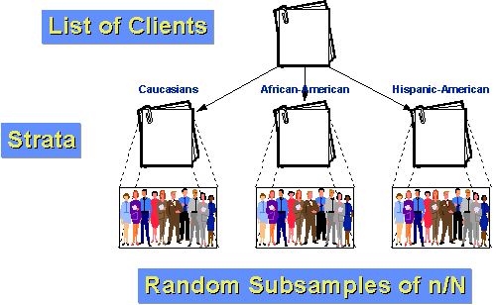
STRATIFIED RANDOM SAMPLING
Population is divided into two or more groups called strata.
Subsamples are randomly selected from each strata.

Slide 11
STRATIFIED RANDOM SAMPLING
  Advantages:
    Assures representation of all groups in sample population
    Characteristics of each stratum can be estimated and comparisons made
  Disadvantages:
    Requires accurate information on proportions of each stratum
    Stratified lists costly to prepare

Slide 12
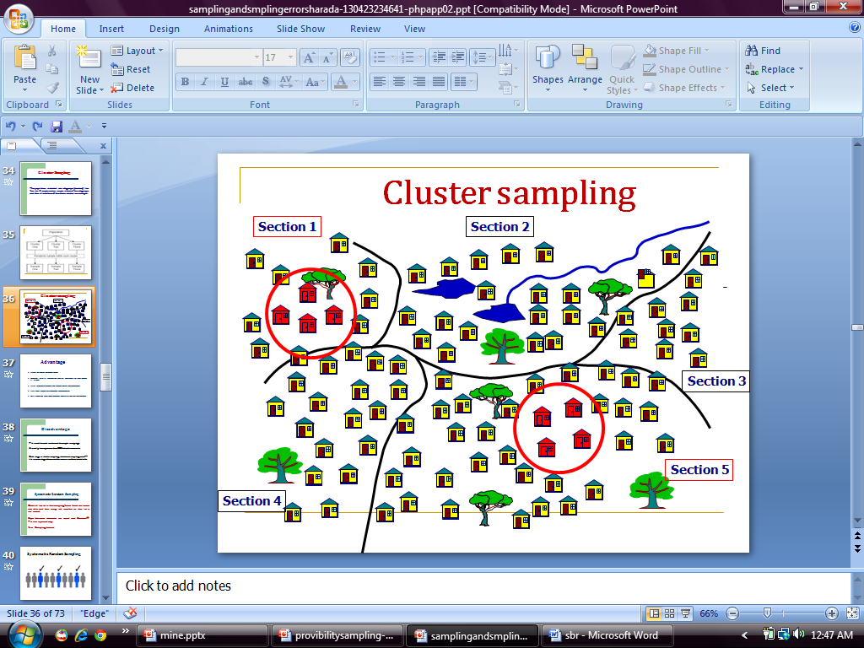
CLUSTER SAMPLING
The population is divided into subgroups (clusters) like families.
A simple random sample is taken from each cluster.

Slide 13
CLUSTER SAMPLING
  Advantages:
    Can estimate characteristics of both cluster and population
  Disadvantages:
    The cost to reach an element to sample is very high
    Each stage in cluster sampling introduces sampling error—the more stages there are, the more error there tends to be

Slide 14
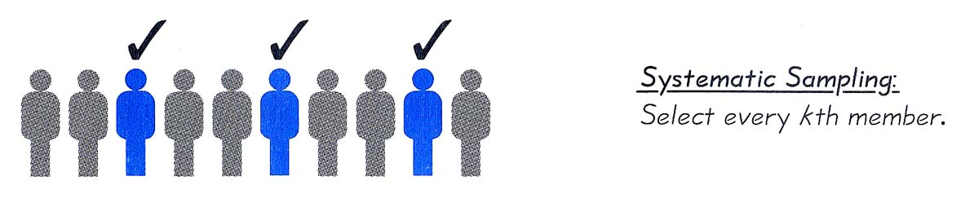
SYSTEMATIC RANDOM SAMPLING
Order all units in the sampling frame
Then every nth number on the list is selected
N= Sampling Interval

Slide 15
SYSTEMATIC RANDOM SAMPLING
  Advantages:
    Moderate cost; moderate usage
    Simple to draw sample
    Easy to verify
  Disadvantages:
    Periodic ordering required

Slide 16
MULTISTAGE SAMPLING
Carried out in stages
Using smaller and smaller sampling units at each stage

Slide 17
MULTISTAGE SAMPLING
  Advantages:
    More Accurate
    More Effective
  Disadvantages:
    Costly
    Each stage in sampling introduces sampling error—the more stages there are, the more error there tends to be.

Slide 18
NONPROBABILITY SAMPLES
The probability of each case being selected from the total population is not known.
Units of the sample are chosen on the basis of personal judgment or convenience.
There are NO statistical techniques for measuring random sampling error in a non-probability sample.

Slide 19
NONPROBABILITY SAMPLING
A. Convenience Sampling
B. Quota Sampling
C. Judgmental Sampling (Purposive Sampling)
D. Snowball sampling
E. Self-selection sampling

Slide 20
A. CONVENIENCE SAMPLING
Convenience sampling involves choosing respondents at the convenience of the researcher.
Advantages
Very low cost
Extensively used/understood
Disadvantages
Variability and bias cannot be measured or controlled
Projecting data beyond sample not justified
Restriction of Generalization.

Slide 21
B. QUOTA SAMPLING
The population is first segmented into mutually exclusive sub-groups, just as in stratified sampling.
Advantages
Used when research budget is limited
Very extensively used/understood
No need for list of population elements
Disadvantages
Variability and bias cannot be measured/controlled
Time Consuming
Projecting data beyond sample not justified

Slide 22
C. JUDGEMENTAL SAMPLING
Researcher employs his or her own "expert” judgment about.
Advantages
There is a assurance of Quality response
Meet the specific objective.
Disadvantages
Bias selection of sample may occur
Time consuming process.

Slide 23
D. SNOWBALL SAMPLING
The research starts with a key person and introduce the next one to become a chain
Advantages
Low cost
Useful in specific circumstances & for locating rare populations
Disadvantages
Not independent
Projecting data beyond sample not justified

Slide 24
E. SELF-SELECTION SAMPLING
It occurs when you allow each case usually individuals, to identify their desire to take part in the research.
Advantages
More accurate
Useful in specific circumstances to serve the purpose.
Disadvantages
More costly due to Advertizing
Mass are left

Slide 25
SAMPLING ERRORS
The errors which arise due to the use of sampling surveys are known as the sampling errors.
Two types of sampling errors
Biased Errors - Due to selection of sampling techniques; size of the sample.
Unbiased Errors / Random sampling errors -Differences between the members of the population included or not included.

Slide 26
METHODS OF REDUCING SAMPLING ERRORS
Specific problem selection.
Systematic documentation of related research.
Effective enumeration.
Effective pre testing.
Controlling methodological bias.
Selection of appropriate sampling techniques.

Slide 27
NON-SAMPLING ERRORS
Non-sampling errors refers to biases and mistakes in selection of sample.
CAUSES FOR NON-SAMPLING ERRORS
    Sampling operations
    Inadequate of response
    Misunderstanding the concept
    Lack of knowledge
    Concealment of the truth.
    Loaded questions
    Processing errors
    Sample size

