Slide 1
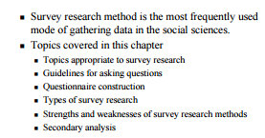
Survey Research

Slide 2
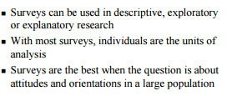
What are the topics appropriate to survey research methods?

Slide 3
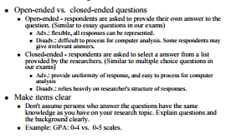
What are the guidelines for asking questions?

Slide 4
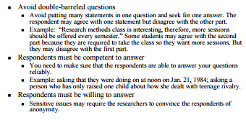
What are the guidelines for asking questions?

Slide 5
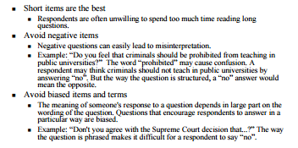
What are the guidelines for asking questions?

Slide 6
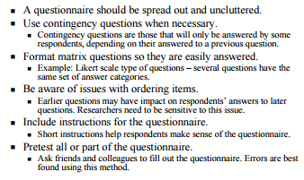
What are the key elements to questionnaire construction?

Slide 7
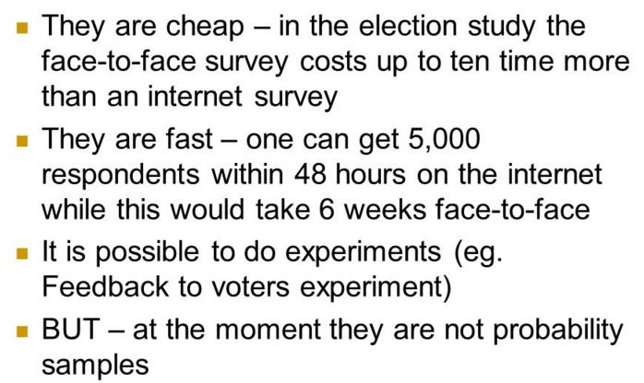
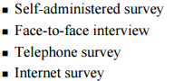
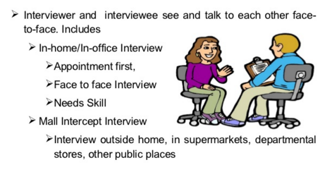
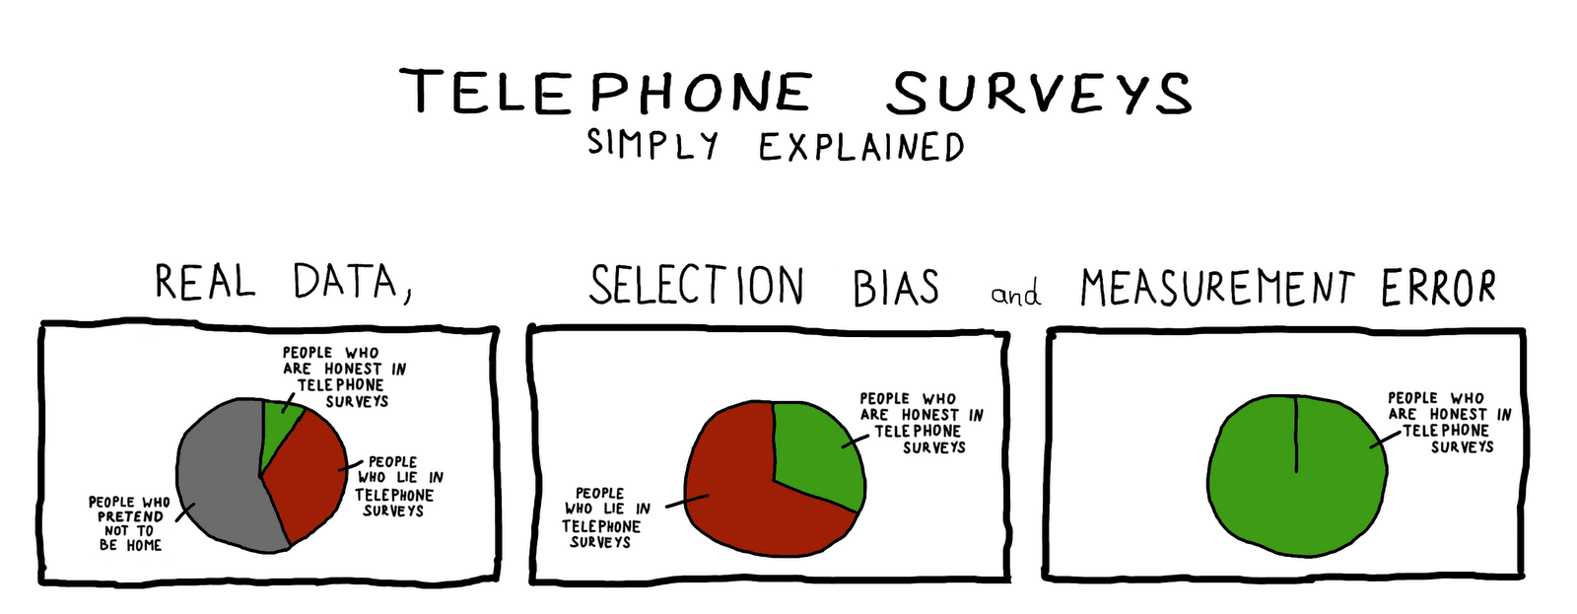
What are the types of survey methods?
Telephone surveys: Advantages

Slide 8
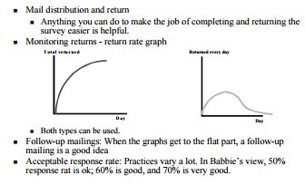
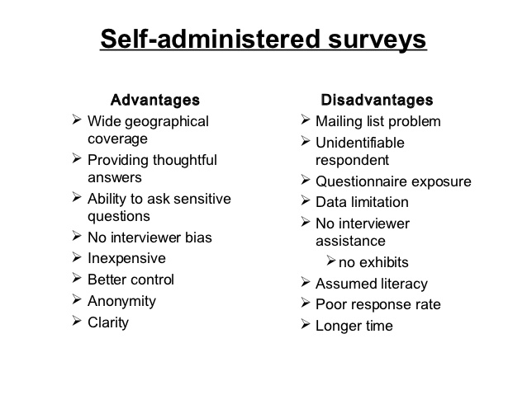
What are the important aspects of self-administered surveys?

Slide 9
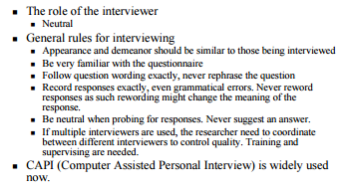
What are the important aspects of face-to- face surveys?

Slide 10
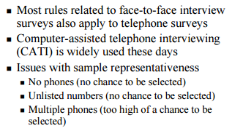
What are the important aspects of telephone surveys?

Slide 11
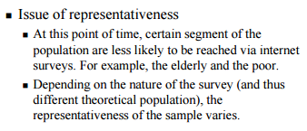
What are the important aspects of internet surveys?

Slide 12
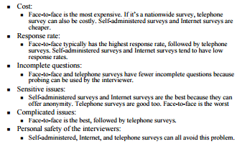
How do these methods compare?

Slide 13
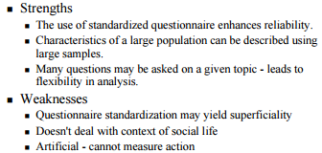
What are the strengths and weaknesses of survey research methods compared to other modes of observation?

Slide 14
How to analyse questionnaire responses?
http://www.nfer.ac.uk/schools/developing-young-researchers/how-to-analyse-questionnaire-responses.cfm
How to present your results?
http://www.nfer.ac.uk/schools/developing-young-researchers/how-to-present-your-results.cfm

