Slide 1
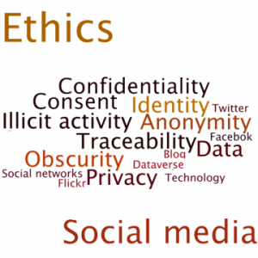
Ethical Issues in Social Research I
Why are ethics important?
Tea Room Trade by Humphreys described research into the lives of “part-time” homosexuals
Lied to participants by telling them he was a voyeur-participant.
Traced participants to their home and interviewed them under false pretenses.
Was Humphreys ethical in doing what he did?
Are there parts of the research that you believe were acceptable and other parts that were not?

Slide 2
Ethical Issues in Social Research II
Voluntary participation (intrusion into people’s lives)
No harm to participants (emotional stress, embarrassment, danger of being identified)
Informed Consent
Anonymity and confidentiality (can’t be identified vs only researchers know identify)

Slide 3
Ethical Issues in Social Research III
Deception: Researchers do not inform subject why the research is being done.
Unjustified Research: Research needs to be justified by compelling scientific or administrative concerns.
Embellishment of findings: Researchers must be honest about their findings and research

Slide 4
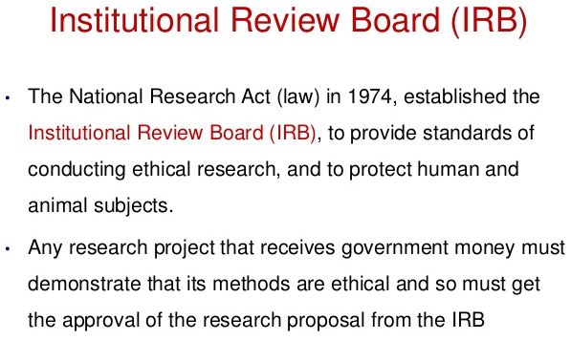
Ethical Issues in
Social Research IV
National laws to protect subjects/respondents.
Institutional Review Boards –Review research proposals involving humans so they can guarantee the rights and interests are protected.
Professional Codes of Ethics – Most professional associa-tions have formal codes of conduct that describe acceptable and unacceptable professional behavior.

Slide 5
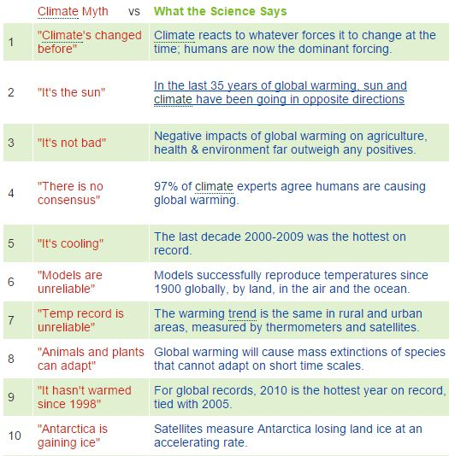
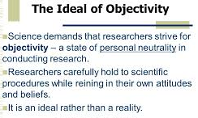
Politics of Social Research
Objectivity of science vs ideology of politics.
Can science by completely objective.
Politics deals with the substance and use of research.
If research results are politically sensitive then the methodology will be attached.

Slide 6
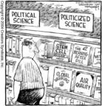
Politics in Perspective
Three issues:
Science is not untouched by politics.
Science does not proceed in the midst of political controversy.
Awareness of ideologies enriches the study and practice of social research methods.

