Slide 1
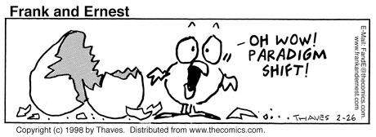
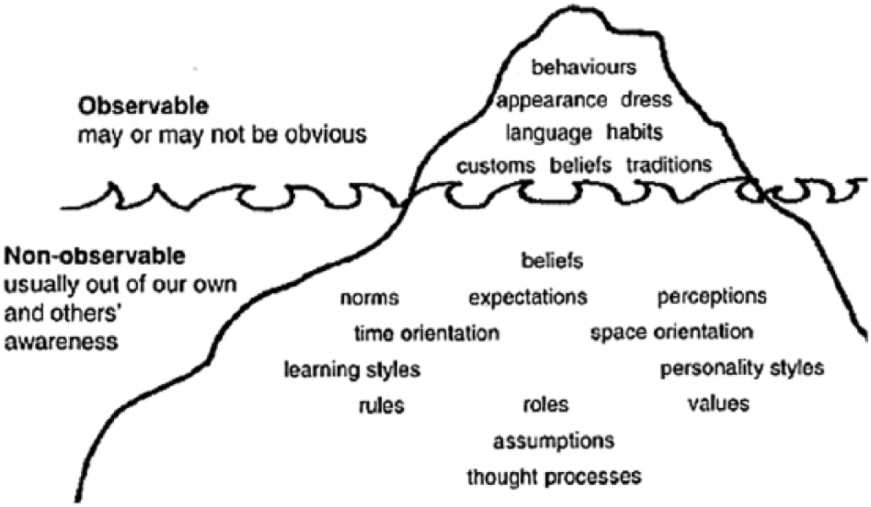
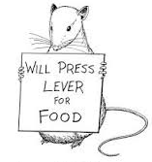
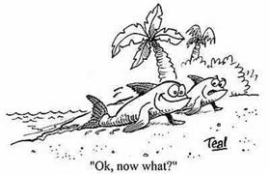
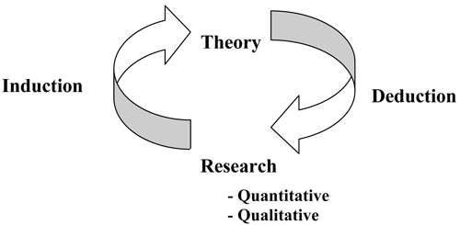
UNIT 2 - PARADIGMS, THEORIES
AND
RESEARCH

Slide 2
UNIT CONTENT
Introduction
Some social science paradigms
Elements of social theory
Two logical systems revisited
Deductive Theory Construction
Inductive Theory Construction
The Links Between Theory and Research

Slide 3
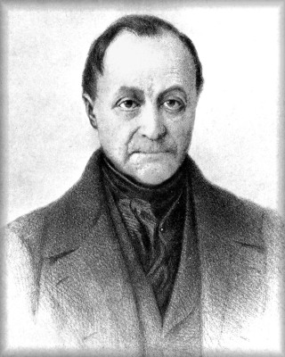
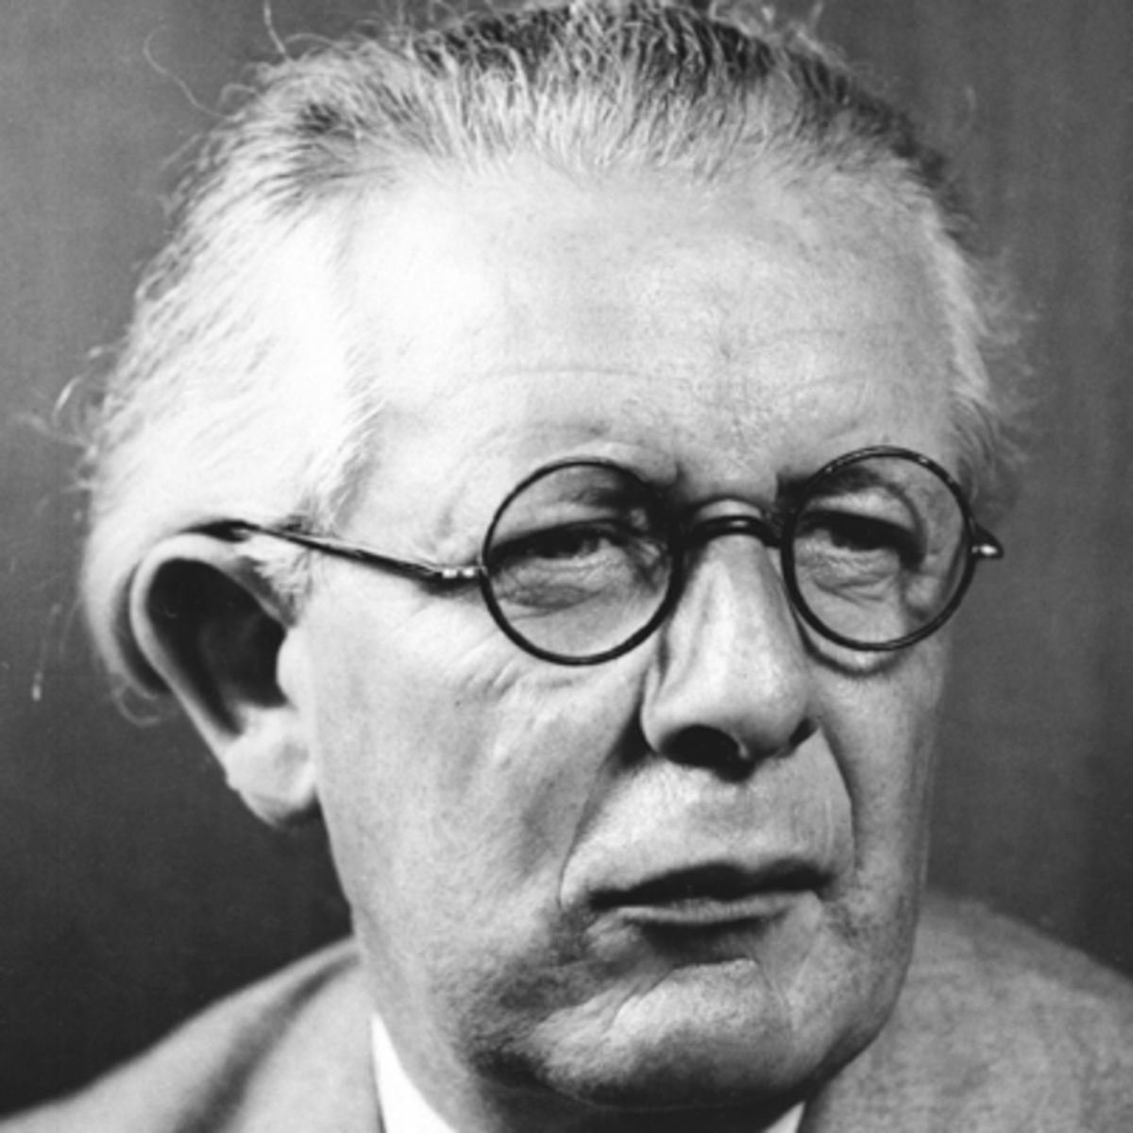
Paradigms
Frames of refe-rence we use to organize our observations and reasoning.
Often implicit, assumed, taken for granted.
We can see new ways of seeing and explaining things when we step outside our paradigm.
Auguste Comte
Jean Piaget
Karl Marx
John Dewey

Slide 4
Social Science Paradigms:
Macrotheory and Microtheory
Macrotheory deals with large, aggregate entities of society or even whole societies.
Struggle between economic classes, international rela-tions, interrelations among major institutions
Microtheory deals with issues of social life at the level of individuals and small groups.
Dating behavior, jury deliberations, student faculty interactions

Slide 5
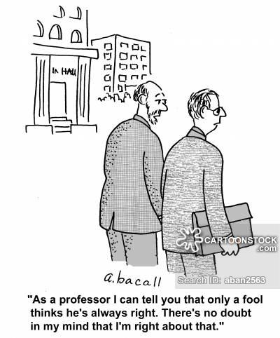
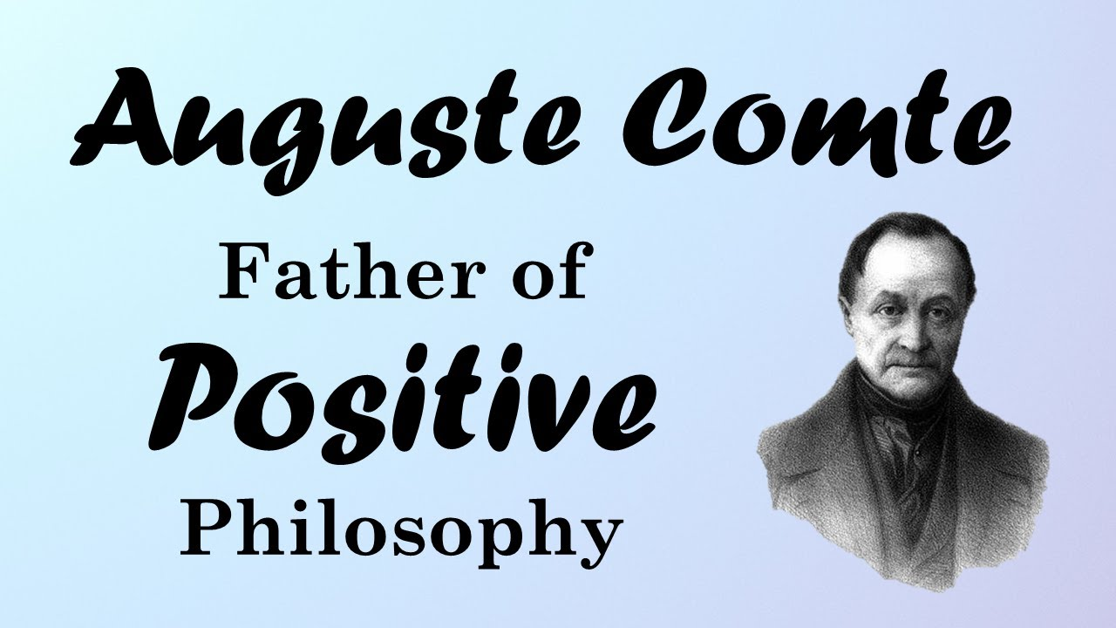
Social Science Paradigms I: Positivism
Comte’s view that science would replace religion and metaphysics by basing knowledge on observations.
All social research descends from Comte’s view that society could be studied scientifically.
Coined the term positivism, in contrast to what he regarded as negative elements in the Enlightenment.
CHARACTERISTICS OF POSITIVISM
Scientific/Mathematical
Rooted in Science
Research is absolute
Deals with objects of the natural world
Observable & Measurable
Global Methods
Hypothesis
Deductive
Quantitative

Slide 6
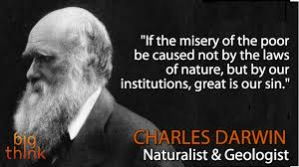
Social Science Paradigms II: Social Darwinism
Scholars began to apply Darwin’s ideas to changes in the structure of human society.
The evolution from hunting-and gathering tribes to large, industrial civilizations was seen as the evolution of progressively “fitter” forms of society.

Slide 7
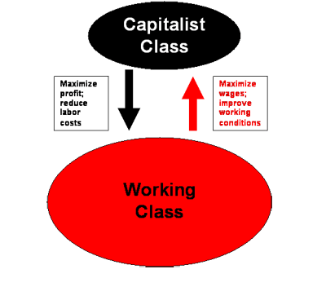
Social Science Paradigms III: Conflict Theory
Karl Marx suggested social behavior could be seen as the process of conflict: the attempt to dominate and avoid being dominated.
Marx focused on the struggle among economic classes.
Georg Simmel was interested in small-scale conflict, rather than class struggles.

Slide 8
Social Science Paradigms IV: Symbolic Interactionism
Interactions revolve around the process of individuals reaching understanding through language and other such systems.
Can lend insights into the nature of interactions in ordinary social life, and help understand unusual forms of interaction.
EXAMPLE: Race & gender as “social constructs”
People’s assumptions about race/gender impact how they interact with each other.
EXAMPLE: Teachers call on & praise boys more often (Jones & Dindia, 2004)
When teachers think that students are smart, they spend more time with them, call on them more often, and praise them more when they are correct Rosenthal & Jacobsen, 1968).

Slide 9
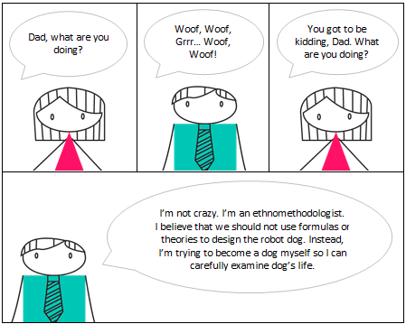
Social Science Paradigms V: Ethnomethodology
“Methodology of the people.”
People are continuously trying to make sense of the life they experience.
One technique used by ethnomethodologists is to break the rules and violate people’s expectations.
ETHNOMETHODOLOGY reveals that there are unspoken rules when people of a common culture talk to each other.
EXAMPLE: People usually take turns and respond to what the other person has just said in an appropriate way

Slide 10
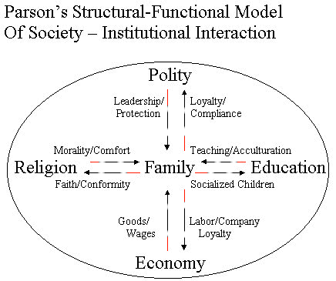
Social Science Paradigms V: Structural Functionalism
A social entity, such as an organization or a whole society, can be viewed as an organism.
A social system is made up of parts, each of which contributes to the fun-ctioning of the whole.
This view looks for the “functions” served by the various com-ponents of society.

Slide 11
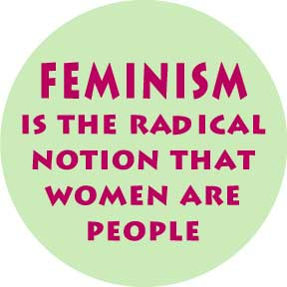
Social Science Paradigms V: Feminism
Focuses on gender differences and how they relate to the rest of social organization.
Draws attention to the oppression of women in many so-cieties, and sheds light on all kinds of oppression.
FEMINIST PARADIGM: The study of women’s lives
Micro: reproduction of gender through language and emotion management.
Macro: constraints and forms of resistance in women’s lives.

Slide 12
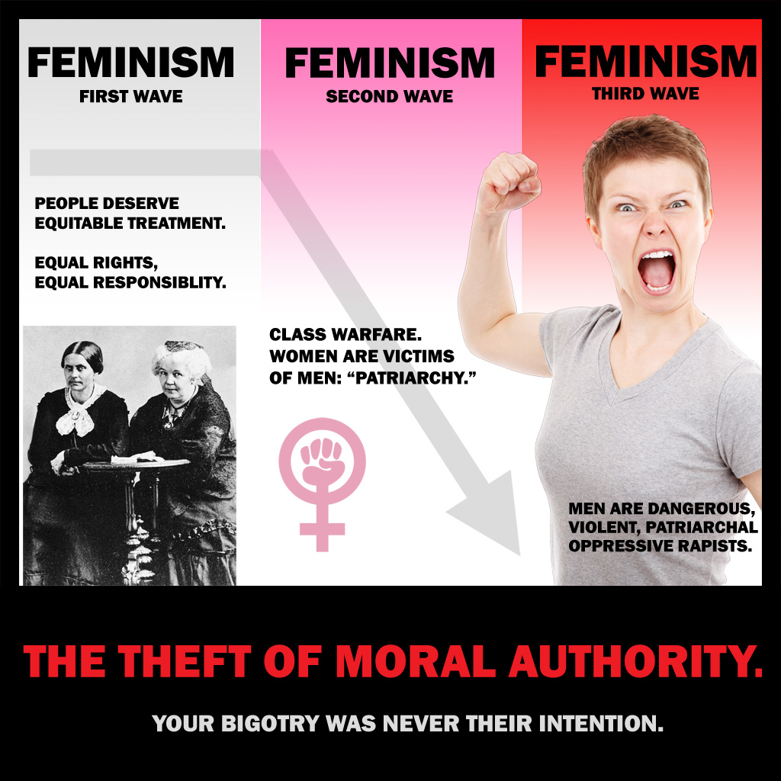
Women’s Ways of Knowing I
Silence: some women feel isolated from knowledge, their lives are largely determined by external authorities.
Received knowledge: taking in knowledge originating with external authorities.

Slide 13
Women’s Ways of Knowing II
Subjective knowledge: personal, subjective knowledge, including intuition.
Procedural knowledge: feeling learned in the ways of gaining knowledge objectively.
Constructed knowledge: view that knowledge is contextual and we are all creators of knowledge.

Slide 14
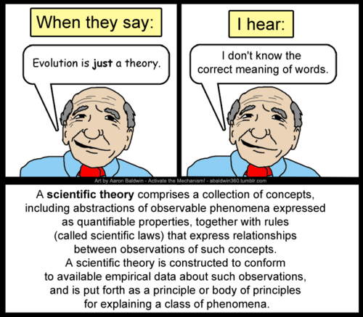
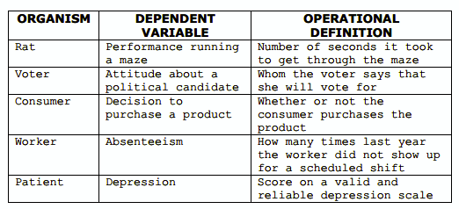
Traditional Model of Science
Three main elements: theory, operationalization & observation.
Develop a Theory.
Develop operational definitions that specify the operations involved in measuring a variable.
Observe and measure of
what is seen.

Slide 15
Deductive Theory Construction
Pick a topic.
Specify a range: Will your theory apply to all of human social life?
Identify major concerns and variables.
Find out what is known about the relationships among the variables.
Reason from those propositions to the topic you are interested in.

Slide 16
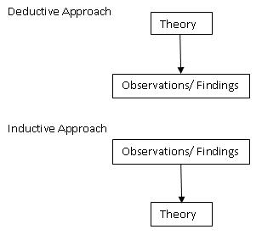
Constructing an Inductive Theory
Observe aspects of social life.
Discover patterns that point to universal principles.

