Slide 1
RESEARCH METHODS MODULE
David Pace
UNIT 1
Human Inquiry and Science

Slide 2
Unit Outline
Looking for reality
Ordinary human inquiry
Tradition
Authority
Errors in inquiry and some solutions
What’s really real?
The foundations of social science
Theory, not philosophy or belief
Social regulations
Aggregates, not individuals
A variable language
Some dialectics of social research
Ideographic and nomothetic explanation
Inductive and deductive theory
Quantitative and qualitative data
Pure and applied research

Slide 3
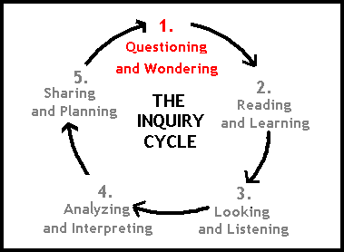
Why do we need to know?
Inquiry is a natural human activity. Much of ordinary human inquiry seeks to explain events and predict future events.

Slide 4
How do we know what we know?
Direct Experience and Observation (experiential reality)
Example: You touch the stove when it’s burning to see if it really is hot.
Agreed-On Knowledge (agreement reality): we consider things to be true because we are told that they are true.
Two types of agreement reality
i. Tradition: the things that “everybody knows”. These can be very culturally related. Example: The earth is round.
ii. Authority: derives from the status of the transmitter of the knowledge – teachers, parents, etc. Example: Things learned in a class.

Slide 5
How do we know what we
know is real /true? –
Looking for reality
We use two criteria to judge
i. Logical support (theory) – A scientific understanding of the world must make logical Sense.
ii. Empirical support (observation) A scientific understanding must not contradict actual Observation.

Slide 6
Do we make mistakes in the process? -
Errors in personal inquiry (I)
1. Inaccurate observations – eyes are not enough. Use measurement devices.
Eg: Think about the last person you talked to before reading this: what kind of shoes was she/he wearing? Most of us cannot remember accurately because we were not paying special attention to that.
How to prevent? - By mandating conscious observation
2. Overgeneralization – assume that a few similar events are evidence of a general pattern:
Eg: Suppose you read two newspaper stories on lazy welfare mothers, you therefore conclude that all welfare mothers are lazy.
3. One or two cases are not enough to lead so such general conclusions.
How to prevent this? - By employing large random samples (you should study many welfare mothers to see if there is a general pattern) and by replicating studies (this should be studied in different cities, at different times, with different samples, and by different researchers).

Slide 7
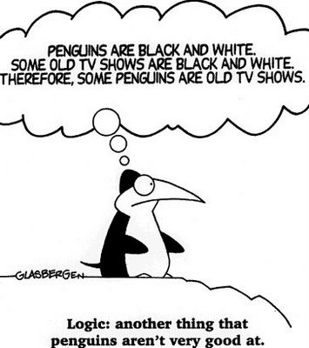
Do we make mistakes in the Process? - Errors in personal inquiry (II)
4. Selective observation - paying attention to events that match a prior conclusion and ignore those that do not.
Eg: In the welfare mother example: when you have formed your opinion that welfare mothers are lazy, you will then pay special attention to other stories on lazy welfare mothers.
How to prevent? - By specifying in advance the number and types of observations to be made and by having several scientists investigate the same phenomenon.
5. Illogical reasoning
Eg: An extended period of good weather may lead you to worry that it is certain to rain on the weekend outdoor event you have planned.
How to prevent? - By using systems of logic consciously and explicitly.

Slide 8
But what is reality/truth? –
Three views of reality
1. Premodern: Things are as they seem to be.
Eg: I think John is very handsome, and that has to be the truth. If other people see him as not, then they are wrong.
2. Modern: Acknowledgment of human subjectivity.
Eg: I think John is very handsome. You think he is so so. And Larry may think John is ugly. The three of us have different ideas (realities), and I can accept that. But there is still the notion that whether somebody is handsome or not can be judged. We just judge them differently.
3. Postmodern: There is no objective reality to be observed.
Eg: There is no such thing as whether somebody is handsome or not. It’s all a matter of subjectivity.

Slide 9
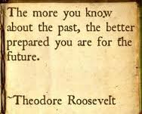
Social Science - an area of study dealing with human society:
History
Geography
Economics
Political Science
Psychology
Sociology
Anthropology
The NEW Social Studies:
Ethnic studies
Criminology
Labour/Industrial Relations
Urban Studies
International Studies
Religious Studies
Women’s Studies
Does social science research answer
what should be?
1. Social science research attempts to answer what is, not what should be.
2. Social science is about fact finding, about finding regularities in social life.
3. Theories should not be confused with philosophy or belief.
Physical Science - the sciences concerned with the study of inanimate natural objects, including physics, chemistry, astronomy, and related subjects.

Slide 10
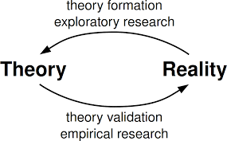
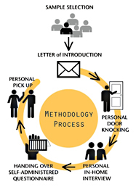
What are the three aspects of the
scientific enterprise?
Social science = theory + data collection + data analysis
1. Theory - deals with logic.
This links back to the logic aspect of judging what is real and what is not. It deals with what is, not what should be. It is not a belief or philosophy.
2. Data collection - deals with observation.
This links back to the observational aspect of judging what is real and what is not.
3. Data analysis - deals with the comparison of what is logically expected with what is actually observed.

Slide 11
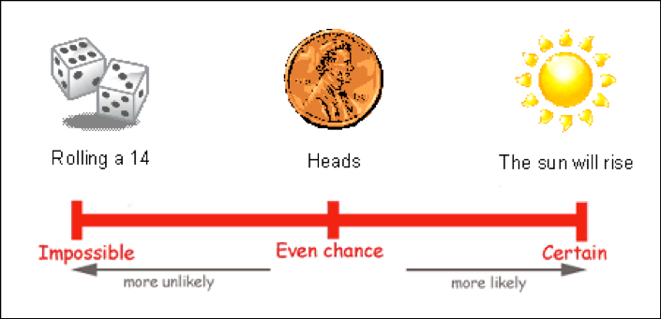
What do we try to find out? – Social Regularities
In large part, social scientific theory aims to find patterns in social life.
Examples:
Only people aged 18 and above
can vote.
Only people with a license can
drive.
Men earn more than women.
How do we deal with exceptions?
If you know your sister earns more than your brother, does that mean the general statement of “Men earn more than women” does not hold any more?
In social science, patterns are probabilistic. As long as in most of the cases, men earn more than women, some exceptions do not void the general rule.

Slide 12
At what level do social regulations hold?
Aggregates mean the collective actions and situations of many individuals.
Example: Social science researchers are interested in the general reasons why people divorce, but not particularly interested in why Mr. and Mrs. Smith decided to get a divorce. We still study Mr. and Mrs. Smith, but only as one observation among many.
The focus of social science is to explain why aggregated patterns of behavior are so regular even when the individuals change over time.
Example: Mr. and Mrs. Smith’s situation may change over time, and may be very different from Mr. and Ms. Johnson. But overall, when you observe 5000 couples, you will find that there are some common factors why people divorce.

Slide 13
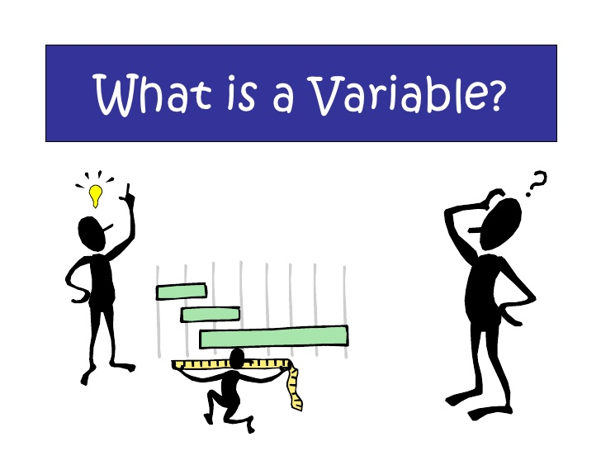
What are variables and attributes?
Theories are written in the language of variables.
Attributes - characteristics or qualities that describe an object (person, in most of our cases).
Examples: White, female, college
educated, mortgage officer, etc.
Variables - logical grouping of attributes
Example: race (White, Black, Asian,
Native Americans, others)
Example: gender (female, male)
Example: education (college educated, not
college educated)
Example: occupation (mortgage officer,
teacher, sale representative, etc. )

Slide 14
How about some more examples of variables and attributes?
Variable | Attribute
Age | Young, middle-aged, old
Family size | 1, 2, 3, 4, 5, 6 ….
Income | High, medium, low
Social class | Upper, middle, lower

Slide 15
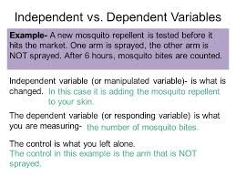
What are independent and dependent variables?
In causal explanation, the presumed cause is the independent variable, while the affected variable is the dependent variable.
Independent variable – cause
A variable with values that are taken as simply given in an analysis
Dependent variable - effect
A variable assumed to be dependent on or be caused by independent variables.
Examples:
The impact of education on income
“Education” is the independent variable (cause), while “income” is the dependent variable (effect).
The impact of parenting style on children’s academic outcome.
“Parenting style” is the independent variable (cause), while “children’s academic outcome” is the dependent variable (effect).
The effect of TV violence on children’s violent behavior.
“TV violence” is the independent variable (cause), while “children’s violent behavior” is the dependent variable (effect).

Slide 16
What are ideographic and nomothetic explanations?
Ideographic explanation: seeks to understand specific cases fully.
Example: A financial counselor tries to find out all the reasons why the Smith family is in financial trouble. There can be 500 reasons on that list.
Nomothetic explanation: seeks a generalized understanding of many similar cases.
Example: A researcher tries to find out the five most important reasons of why people file for personal bankruptcy.
Most social science research uses the nomothetic approach.
Ideographic approach is mostly used in historical studies and clinical diagnosis.

Slide 17
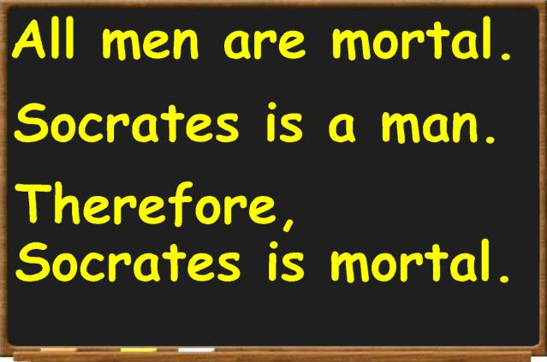
What are inductive and deductive theories?
Inductive theories – reason from specific observations to general patterns.
Example: You observe among your classmates that those who study more hours tend to get better grades on exams. Those who study less tend to get lower grades. Then you come up with a pattern: the more one studies, the better chance one can get a better grade.
Deductive theories – start from general statements and predict specific observations.
Example: Logically, you believe if one puts more effort into studying, one can do better on exams. Thus you predict those students who study more will do better on exams.

Slide 18
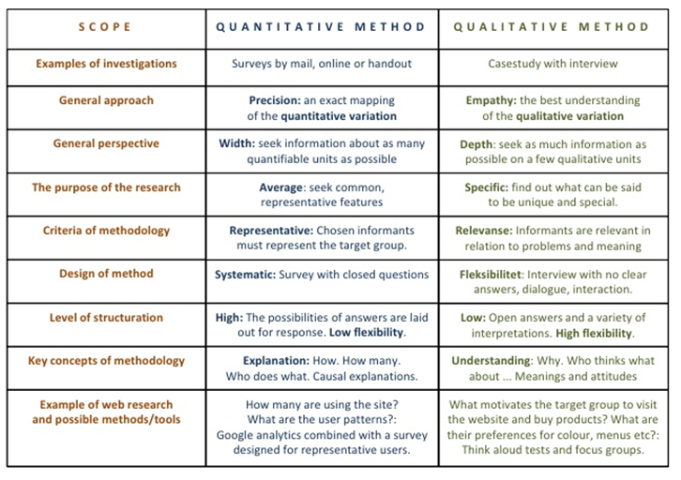
What are quantitative and qualitative data?
Quantitative data: numerical
Qualitative data: non-numerical
Both approaches are useful for different research purposes.
CHARACTERISTICS

Slide 19
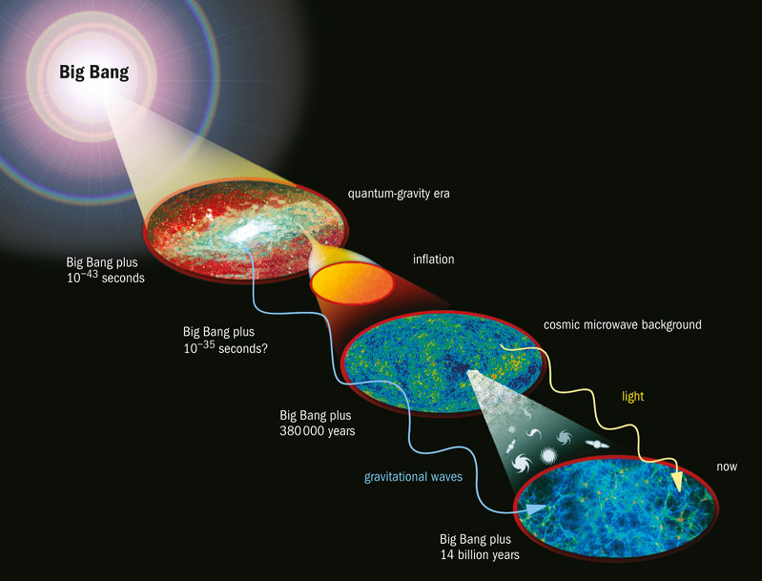
What are pure and applied research?
Pure research – knowledge for its own sake.
Applied research – use knowledge to make things in the society better.
Both are valid and vital parts of the social research enterprise.

